Slide 1
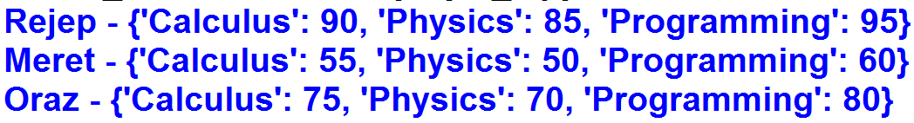
1. Create a Nested Dictionary and print.
Dictionary keys: "Rejep", "Meret", "Oraz"
Dictionary values: Another Dictionary
Another Dictionary keys: "Calculus", "Physics", "Programming"
Another Dictionary values: Exam grades
Output

Slide 2
2. Print Rejep's all exam grades.
Output

Slide 3

3. Print Meret's Calculus exam grade and Oraz's Physics exam grade.
Output

Slide 4
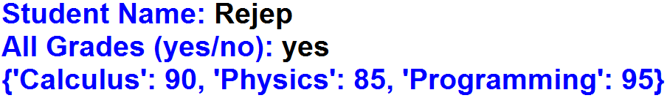
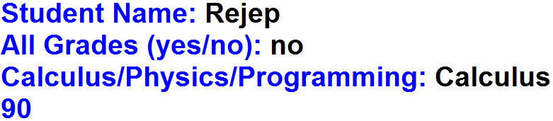

4. Write the code for the following application.
Output
Output
Output

Slide 5
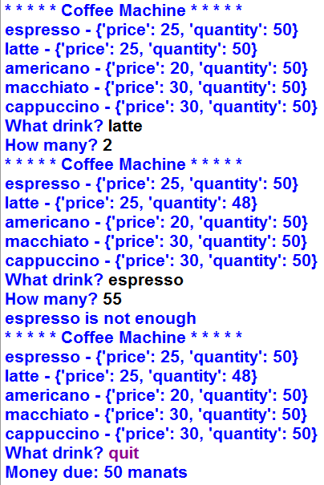
5. Write the code for the following application.
Output
A = { "espresso" : {"price" : 25, "quantity" : 50},
"latte" : {"price" : 25, "quantity" : 50},
"americano" : {"price" : 20, "quantity" : 50},
"macchiato" : {"price" : 30, "quantity" : 50},
"cappuccino" : {"price" : 30, "quantity" : 50} }

Slide 6
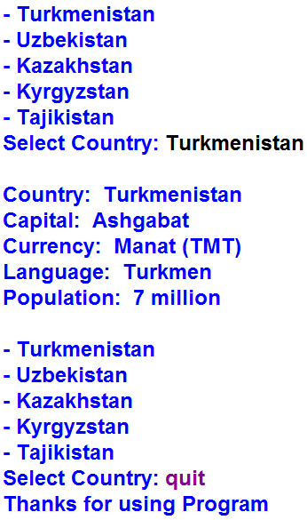
6. Write the code for the following application.
Output
A = { "Turkmenistan": { "Capital": "Ashgabat",
"Currency": "Manat (TMT)",
"Language": "Turkmen",
"Population": "7 million" },
"Uzbekistan": { "Capital": "Tashkent",
"Currency": "Som (UZS)",
"Language": "Uzbek",
"Population": "37 million" },
"Kazakhstan": { "Capital": "Astana",
"Currency": "Tenge (KZT)",
"Language": "Kazakh",
"Population": "20 million" },
"Kyrgyzstan": { "Capital": "Bishkek",
"Currency": "Som (KGS)",
"Language": "Kyrgyz",
"Population": "7 million" },
"Tajikistan": { "Capital": "Dushanbe",
"Currency": "Somoni (TJS)",
"Language": "Tajik",
"Population": "10 million" } }

